Slide 1
IEEE 802.11

Slide 2
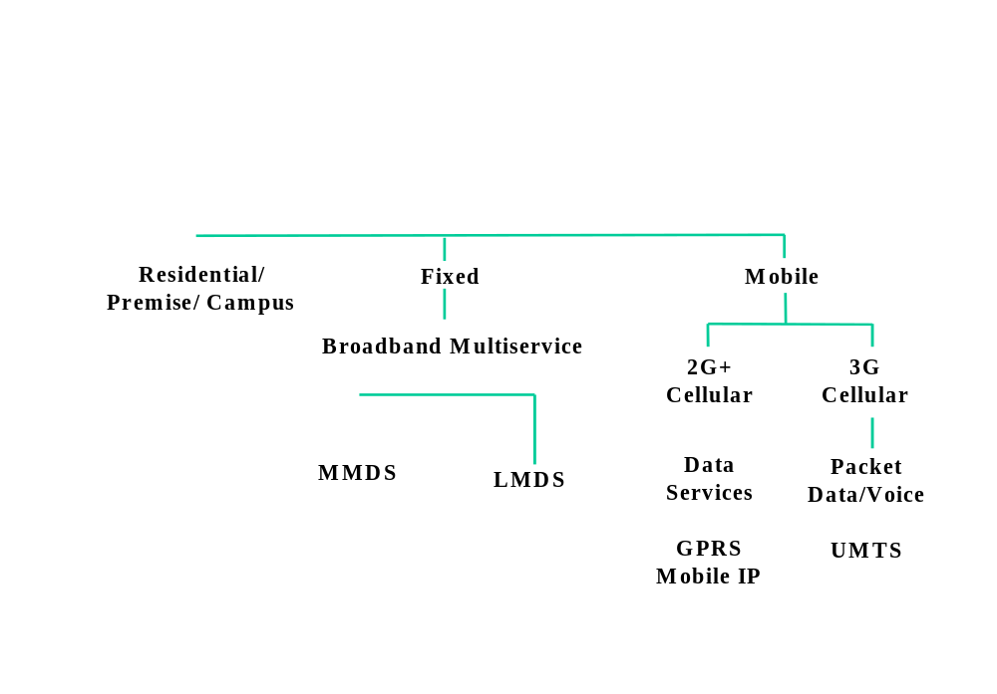
Wireless Market Segments

Slide 3
Standardization of Wireless Networks
Wireless networks are standardized by IEEE.
Under 802 LAN MAN standards committee.
Application
Presentation
ISO
OSI
7-layer
model
Session
IEEE 802
standards
Transport
Network
Logical Link Control
Data Link
Medium Access (MAC)
Physical
Physical (PHY)
Notes:
Same organization that came up with IEEE 802.3 Ethernet,
which is responsible for success of Internet

Slide 4
IEEE 802.11 Overview
Adopted in 1997.
Defines;
MAC sublayer
MAC management protocols and services
Physical (PHY) layers
  IR
  FHSS
  DSSS
Goals
To deliver services in wired networks
To achieve high throughput
To achieve highly reliable data delivery
To achieve continuous network connection.

Slide 5
Components
Station
BSS - Basic Service Set
  IBSS : Infrastructure BSS : QBSS
ESS - Extended Service Set
  A set of infrastrucute BSSs.
  Connection of APs
  Tracking of mobility
DS – Distribution System
  AP communicates with another

Slide 6
Services
Station services:
  authentication,
  de-authentication,
  privacy,
  delivery of data
Distribution Services ( layer between MAC and LLC sublayer)
  association
  disassociation
  reassociation
  distribution
  Integration
A station maintain two variables:
authentication state (=> 1)
association state (<= 1)

Slide 7
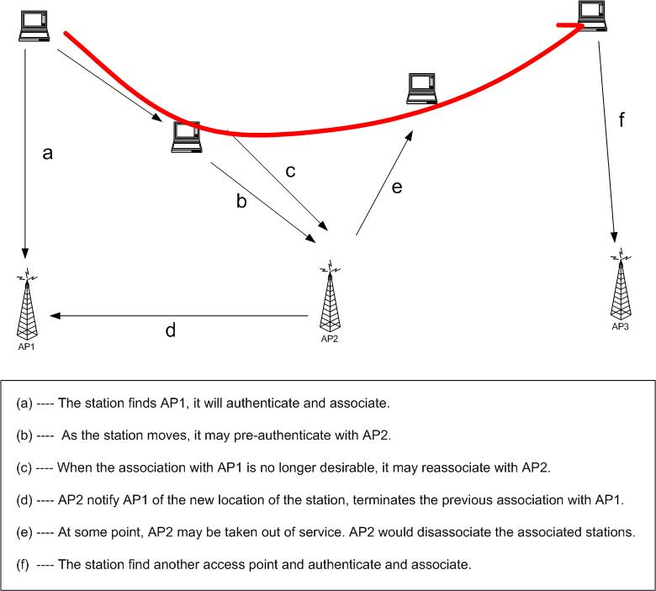

Slide 8
Medium Access Control
Functionality;
Reliable data delivery
Fairly control access
Protection of data
Deals;
Noisy and unreliable medium
Frame exchange protocol - ACK
Overhead to IEEE 802.3 -
Hidden Node Problem – RTS/CTS
Participation of all stations
Reaction to every frame

Slide 9
MAC
Retry Counters
  Short retry counter
  Long retry counter
  Lifetime timer
Basic Access Mechanism
  CSMA/CA
  Binary exponential back-off
  NAV – Network Allocation Vector
Timing Intervals: SIFS, Slot Time, PIFS, DIFS, EIFS
DCF Operation
PCF Operation

Slide 10
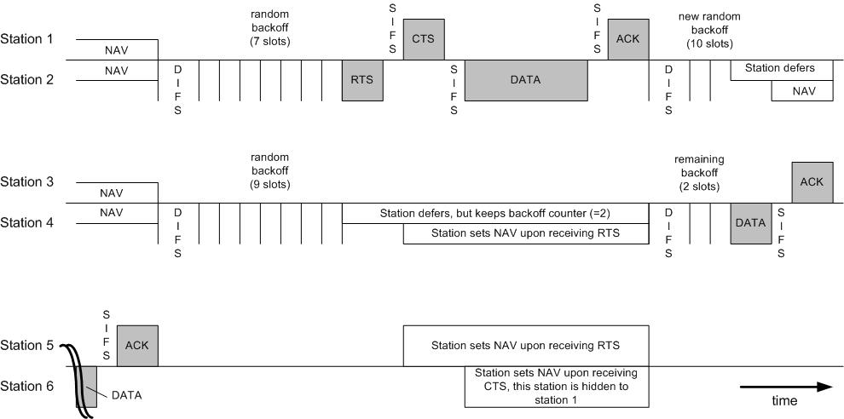
DCF Operation

Slide 11
PCF Operation
Poll – eliminates contention
PC – Point Coordinator
  Polling List
  Over DCF
  PIFS
CFP – Contention Free Period
  Alternate with DCF
Periodic Beacon – contains length of CFP
CF-Poll – Contention Free Poll
NAV prevents during CFP
CF-End – resets NAV

Slide 12
Frame Types
NAV information
Or
Short Id for PS-Poll
Upper layer data
2048 byte max
256 upper layer header
FC
Duration
/ID
Address
1
Address
2
Address
3
Sequence
Control
Address
4
DATA
FCS
2 2 6 6 6 2 6 0-2312 4 bytes
Protocol Version
Frame Type and Sub Type
To DS and From DS
More Fragments
Retry
Power Management
More Data
WEP
Order
IEEE 48 bit address
Individual/Group
Universal/Local
46 bit address
MSDU
Sequence Number
Fragment Number
CCIT CRC-32 Polynomial
BSSID –BSS Identifier
TA - Transmitter
RA - Receiver
SA - Source
DA - Destination

Slide 13
Frame Subtypes
CONTROL
DATA
MANAGEMENT
RTS
CTS
ACK
PS-Poll
CF-End & CF-End ACK
Data
Data+CF-ACK
Data+CF-Poll
Data+CF-ACK+CF-Poll
Null Function
CF-ACK (nodata)
CF-Poll (nodata)
CF-ACK+CF+Poll
Beacon
Probe Request & Response
Authentication
Deauthentication
Association Request & Response
Reassociation Request & Response
Disassociation
Announcement Traffic Indication Message (ATIM)

Slide 14
Other MAC Operations
Fragmentation
  Sequence control field
  In burst
  Medium is reserved
  NAV is updated by ACK
WEP Details
  Two mechanism
    Default keys
    Key mapping
  WEP header and trailer
    KEYID in header
    ICV in trailer
  dot11UndecryptableCount
    Indicates an attack.
  dot11ICVErrorCount
    Attack to determine a key is in progress.
Privacy
  WEP bit set when encrypted.
  Only the frame body.
  Medium is reserved
  NAV is updated by ACK
  Symmetric variable key

Slide 15
MAC Management
Interference by users that have no concept of data communication. Ex: Microwave
Interference by other WLANs
Security of data
Mobility
Power Management

Slide 16
Authentication
Authentication
  Prove identity to another station.
  Open system authentication
  Shared key authentication
    A sends
    B responds with a text
    A encrypt and send back
    B decrypts and returns an authentication management frame.
  May authenticate any number of station.
Security Problem
  A rogue AP
    SSID of ESS
    Announce its presence with beaconing
    A active rogue reach higher layer data if unencrypted.

Slide 17
Association
Association
  Transparent mobility
  After authentication
  Association request to an AP
  After established, forward data
  To BSS, if DA is in the BSS.
  To DS, if DA is outside the BSS.
  To AP, if DA is in another BSS.
  To “portal”, if DC is outside the ESS.
  Portal : transfer point : track mobility. (AP, bridge, or router) transfer 802.1h
  New AP after reassociation, communicates with the old AP.

Slide 18
Address Filtering
More than one WLAN
Three Addresses
Receiver examine the DA, BSSID
Privacy MAC Function
WEP Mechanism

Slide 19
Power Management
Independent BSS
  Distributed
  Data frame handshake
  Wake up every beacon.
  Awake a period of ATIM after each beacon.
  Send ACK if receive ATIM frame & awake until the end of next ATIM.
  Estimate the power saving station, and delay until the next ATIM.
  Multicast frame : No ACK : optional
Overhead
  Sender
    Announcement frame
    Buffer
    Power consumption in ATIM
  Receiver
    Awake for every Beacon and ATIM

Slide 20
Power Management
Infrastructure BSS
  Centralized in the AP.
  Greater power saving
  Mobile Station sleeps for a number of beacon periods.
  Awake for multicast indicated in DTIM in Beacon.
  AP buffer, indicate in TIM
  Mobile requests by PS-Poll

Slide 21
Synchronization
Timer Synchronization in an Infrastructure BSS
  Beacon contains TSF
  Station updates its with the TSF in beacon.
Timer Synchronization in an IBSS
  Distributed. Starter of the BSS send TSF zero and increments.
  Each Station sends a Beacon
  Station updates if the TSF is bigger.
  Small number of stations: the fastest timer value
  Large number of stations: slower timer value due to collision.
Synchronization with Frequency Hopping PHY Layers
  Changes in a frequency hopping PHY layer occurs periodically (the dwell meriod).
  Change to new channel when the TSF timer value, modulo the dwell period, is zero

Slide 22
Scanning & Joining
Scanning
  Passive Scanning : only listens for Beacon and get info of the BSS. Power is saved.
  Active Scanning: transmit and elicit response from APs. If IBSS, last station that transmitted beacon responds. Time is saved.
Joining a BSS
  Syncronization in TSF and frequency : Adopt PHY parameters : The BSSID : WEP : Beacon Period : DTIM

Slide 23
Combining Management Tools
Combine Power Saving Periods with Scanning
  Instead of entering power saving mode, perform active scanning.
  Gather information about its environments.
Preauthentication
  Scans and initiate an authentication
  Reduces the time

Slide 24
The Physical Layer
    PLCP: frame exchange between the MAC and PHY
    PMD: uses signal carrier and spread spectrum modulation to transmit data frames over the media.
  Direct Sequence Spread Spectrum (DSSS) PHY
    2.4 GHz : RF : 1 – 2 Mbps
  The Frequency Hopping Spread Spectrum (FHSS) PHY
    110KHz deviation : RF : PMD controls channel hopping : 2 Mbps
  Infrared (IR) PHY
    Indoor : IR : 1 and 2 Mbps
  The OFDM PHY – IEEE 802.11a
    5.0 GHz : 6-54 Mbps :
  High Rate DSSS PHY – IEEE 802.11b
    2.4 GHz : 5.5 Mbps – 11 Mbps :

Slide 25
IEEE 802.11E
  EDCF - Enhanced DCF
  HCF - Hybrid Coordination Function
  QBSS
  HC – Hybrid Controller
  TC – Traffic Categories
  TXOP – Transmission Opportunity
    – granted by EDCF-TXOP or HC- poll TXOP
  AIFS – Arbitration Interframe Space

Slide 26
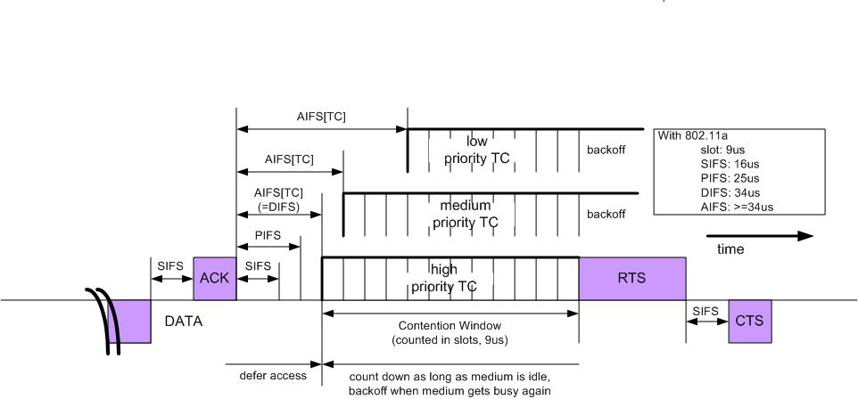
IEEE 802.11E

Slide 27
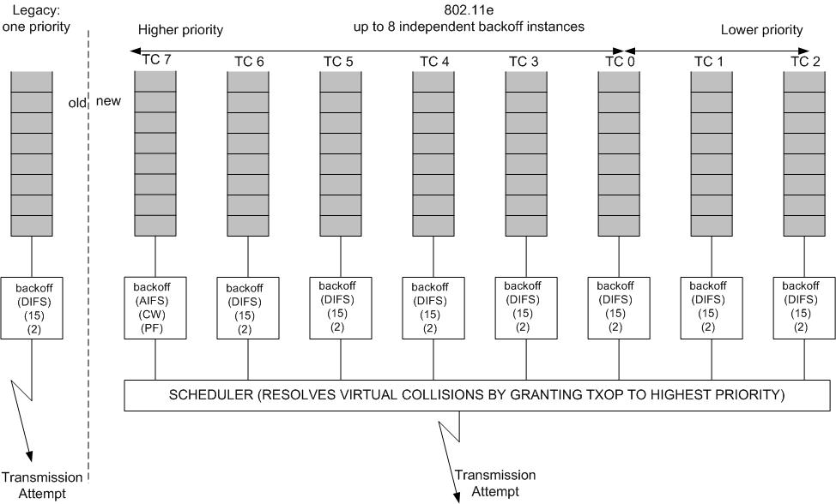
IEEE 802.11E Backoff

Slide 28
IEEE 802.11 Protocols
  IEEE 802.11a
    PHY Standard : 8 channels : 54 Mbps : Products are available.
  IEEE 802.11b
    PHY Standard : 3 channels : 11 Mbps : Products are available.
  IEEE 802.11d
    MAC Standard : operate in variable power levels : ongoing
  IEEE 802.11e
    MAC Standard : QoS support : Second half of 2002.
  IEEE 802.11f
    Inter-Access Point Protocol : 2nd half 2002
  IEEE 802.11g
    PHY Standard: 3 channels : OFDM and PBCC : 2nd half 2002
  IEEE 802.11h
    Supplementary MAC Standard: TPC and DFS : 2nd half 2002
  IEEE 802.11i
    Supplementary MAC Standard: Alternative WEP : 2nd half 2002

Slide 29
APPENDIX

Slide 30
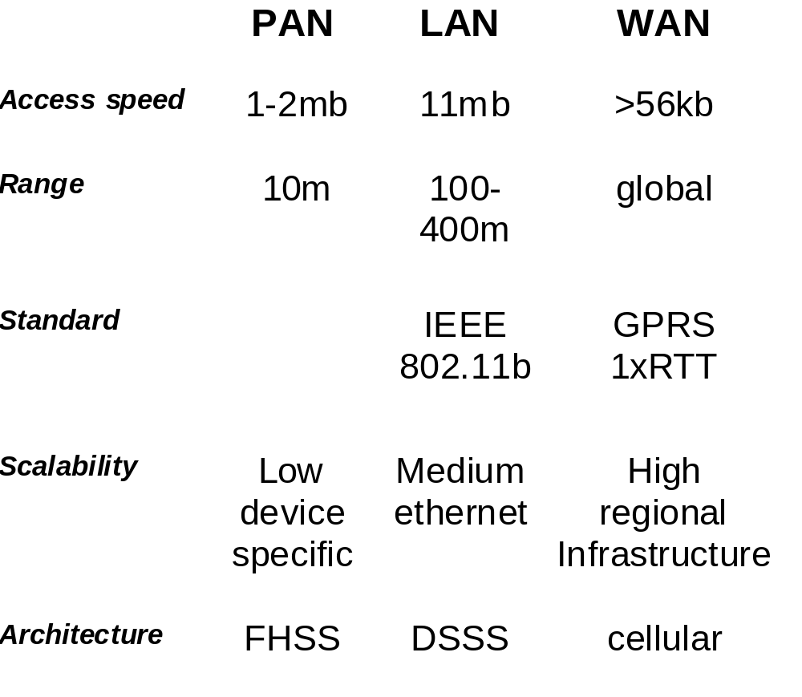
The Basics of WLANs

Slide 31
WLAN Pending Issues
Why 802.11a?
  Greater bandwidth (54Mb)
  Less potential interference (5GHz)
  More non-overlapping channels
Why 802.11b?
  Widely available
  Greater range, lower power needs
Why 802.11g?
  Faster than 802.11b (24Mb vs 11Mb)

Slide 32
Deployment Issues
  Re-purpose Symbol AP’s for secure admin services
  Deploy 802.11b with 802.11a in mind (25db SNR for all service areas)
  Delay migration to 802.11a until dual function (11b & 11a) cards become available

Slide 33
Frequency Bands- ISM
Industrial, Scientific, and Medical (ISM) bands
Unlicensed, 22 MHz channel bandwidth
Short Wave Radio
FM Broadcast
AM Broadcast
Television
Infrared wireless LAN
Audio
Cellular (840MHz)
NPCS (1.9GHz)
Extremely
Low
Very
Low
Low
Medium
High
Very
High
Ultra
High
Super
High
Infrared
Visible
Light
Ultra-
violet
X-Rays
902 - 928 MHz
26 MHz
2.4 - 2.4835 GHz
83.5 MHz
(IEEE 802.11)
5 GHz
(IEEE 802.11)
HyperLAN
HyperLAN2

Slide 34
IEEE 802.11i Enhanced Security
Description | Enhancements to the 802.11 MAC standard to increase the security; addresses new encryption methods and upper layer authentication
Importance | High: weakness of WEP encryption is damaging the 802.11 standard perception in the market
Related standards | This applies to 802.11b, 802.11a and 802.11g systems. 802.1x is key reference for upper layer authentication
Status + Roadmap | Enhanced encryption software will replace WEP software; This is on a recommended best practice /voluntary basis; development in TgI: first draft Mar 2001; next draft due Mar 2002; stable draft: July 2002; final standard: Jan 2003
Products affected | Client and AP cards (Controller chip, Firmware, Driver) AP kernel, RG kernel, BG kernel
Agere’s activity | Actively proposing WEP improvement methods, participating in all official/interim meetings
Key players | Agere/Microsoft/Agere/Cisco/Atheros/Intel/3Com/Intersil/Symbol/Certicom/RSA/Funk
Key issues | Mode of AES to use for encryption (CTR/CBC [CBC MIC] or OCB [MIC and Encryption function])

Slide 35
IEEE 802.1X - Port Based Control
Description | A framework for regulating access control of client stations to a network via the use of extensible authentication methods
Importance | High: forms a key part of the important 802.11i proposals for enhanced security
Related standards | This applies to 802.11b, 802.11a and 802.11g systems
Status + Roadmap | Standard available – Spring 2001
Products affected | Supported in AP-2000, AP-1000/500, Clients (MS drivers for XP/2000 beta)
Agere’s activity | Adding EAP auth types to products
Key players | Microsoft/Cisco/Certicom/RSA/Funk
Key issues | Home in IETF for EAP method discussions

Slide 36
IEEE 802.1p - Traffic Class
Reference | IEEE 802.1p (Traffic Class and Dynamic Multicast Filtering)
Description | A method to differentiate traffic streams in priotity classes in support of quality of service offering
Importance | Medium: forms a key part of the 802.11e proposals for QoS at the MAC level
Related standards | This applies to 802.11b, 802.11a and 802.11g systems; is an addition to the 802.1d Bridge standard (annex H).
Status + Roadmap | Final standard; incorporated in 1998 edition of 802.1d (annex H)
Products affected | Client and AP cards (Driver); AP kernel, RG kernel, BG kernel
Agere’s activity | Investigating implementation options
Key players | N/A
Key issues | N/A

Slide 37
Glossary of 802.11 Wireless Terms, cont.
BSSID & ESSID: Data fields identifying a stations BSS & ESS.
Clear Channel Assessment (CCA): A station function used to determine when it is OK to transmit.
Association: A function that maps a station to an Access Point.
MAC Service Data Unit (MSDU): Data Frame passed between user & MAC.
MAC Protocol Data Unit (MPDU): Data Frame passed between MAC & PHY.
PLCP Packet (PLCP_PDU): Data Packet passed from PHY to PHY over the Wireless Medium.

Slide 38
Overview, 802.11 Architecture
ESS
Existing Wired LAN
AP
AP
STA
BSS
STA
STA
BSS
STA
Infrastructure Network
STA
STA
Ad Hoc Network
BSS
BSS
Ad Hoc Network
STA
STA

Slide 39
Frequency Hopping and Direct Sequence Spread Spectrum Techniques
Spread Spectrum used to avoid interference from licensed and other non-licensed users, and from noise, e.g., microwave ovens
Frequency Hopping (FHSS)
  Using one of 78 hop sequences, hop to a new 1MHz channel (out of the total of 79 channels) at least every 400milliseconds
    Requires hop acquisition and synchronization
    Hops away from interference
Direct Sequence (DSSS)
  Using one of 11 overlapping channels, multiply the data by an 11-bit number to spread the 1M-symbol/sec data over 11MHz
    Requires RF linearity over 11MHz
    Spreading yields processing gain at receiver
    Less immune to interference

Slide 40
802.11 Physical Layer
Preamble Sync, 16-bit Start Frame Delimiter, PLCP Header including 16-bit Header CRC, MPDU, 32-bit CRC
FHSS
  2 & 4GFSK
  Data Whitening for Bias Suppression
    32/33 bit stuffing and block inversion
    7-bit LFSR scrambler
  80-bit Preamble Sync pattern
  32-bit Header
DSSS
  DBPSK & DQPSK
  Data Scrambling using 8-bit LFSR
  128-bit Preamble Sync pattern
  48-bit Header

Slide 41
802.11 Physical Layer, cont.
Antenna Diversity
  Multipath fading a signal can inhibit reception
  Multiple antennas can significantly minimize
  Spacial Separation of Orthoganality
  Choose Antenna during Preamble Sync pattern
    Presence of Preamble Sync pattern
    Presence of energy
      RSSI - Received Signal Strength Indication
    Combination of both
Clear Channel Assessment
  Require reliable indication that channel is in use to defer transmission
  Use same mechanisms as for Antenna Diversity
  Use NAV information

Slide 42
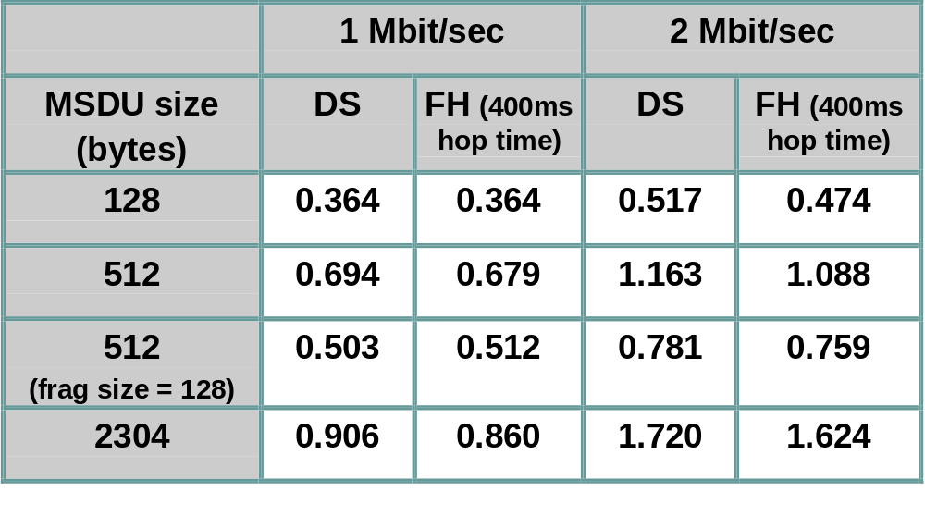
Performance, Theoretical Maximum Throughput
Throughput numbers in Mbits/sec:
  Assumes 100ms beacon interval, RTS, CTS used, no collision
  Slide courtesy of Matt Fischer, AMD

